Slide 1
Analysis of fast-food restaurants in the us
Khanh chi Nguyen
Msds 670 – final project
Notes:
Hello, my name is Chi and this is my week 6 task

Slide 2
Table of content
Introduction
Terminology
Methodology
Research Question
Data Analysis
Conclusions

Slide 3
introduction
This data set provides information about Fast-food restaurant in the US. The data set is shared on Kaggle.
Link of data is here: https://www.kaggle.com/datasets/thedevastator/fast-food-restaurants-in-the-united-states

Slide 4
terminology
In this analysis, there is a feature name “categories” which contains information about the types of restaurant such as: American food, Mexican food, Asian food, Sandwich, Ice cream, etc. There are more than 50 unique values of this feature, so I decide to simplify it as below rules:
﻿group 1: fast food, burger, sandwich, pizza, & others -> Fast Food
group 2: Fast-food + American food -> American Food
group 3: Fast-food + Mexican, taco -> Mexican food
group 4: Fast-food + gas station, convenient, mall store -> Gas, Convenient, Mall
group 5: Fast-food + ice cream shop -> Ice-cream
group 6: Fast-food + Asian, Chinese, sushi -> Asian Food

Slide 5
Methodology
The purpose of the dataset is to have an analysis about fast-food restaurants in the US. I will use geopandas, matplotlib, plotly, and pandas for the analysis.
I used Spyder as the main coding software and Jupyter Notebook as the supportive software.
In Spyder, I can’t export the choropleth map to image, so I exported it by Jupyter Notebook.
Notes:
https://www.youtube.com/watch?v=o13rHfbA6bM
https://www.reach-initiative.org/what-we-do/news/syria-reachs-rapid-assessment-of-displacement-and-needs-in-southwest-dara-governorate/

Slide 6
Research question
US is well known as the country of fast-food, so if the ‘fast-food’ type is the biggest type of restaurant?
Where are they most located?
And which brands are overwhelming the industry?

Slide 7
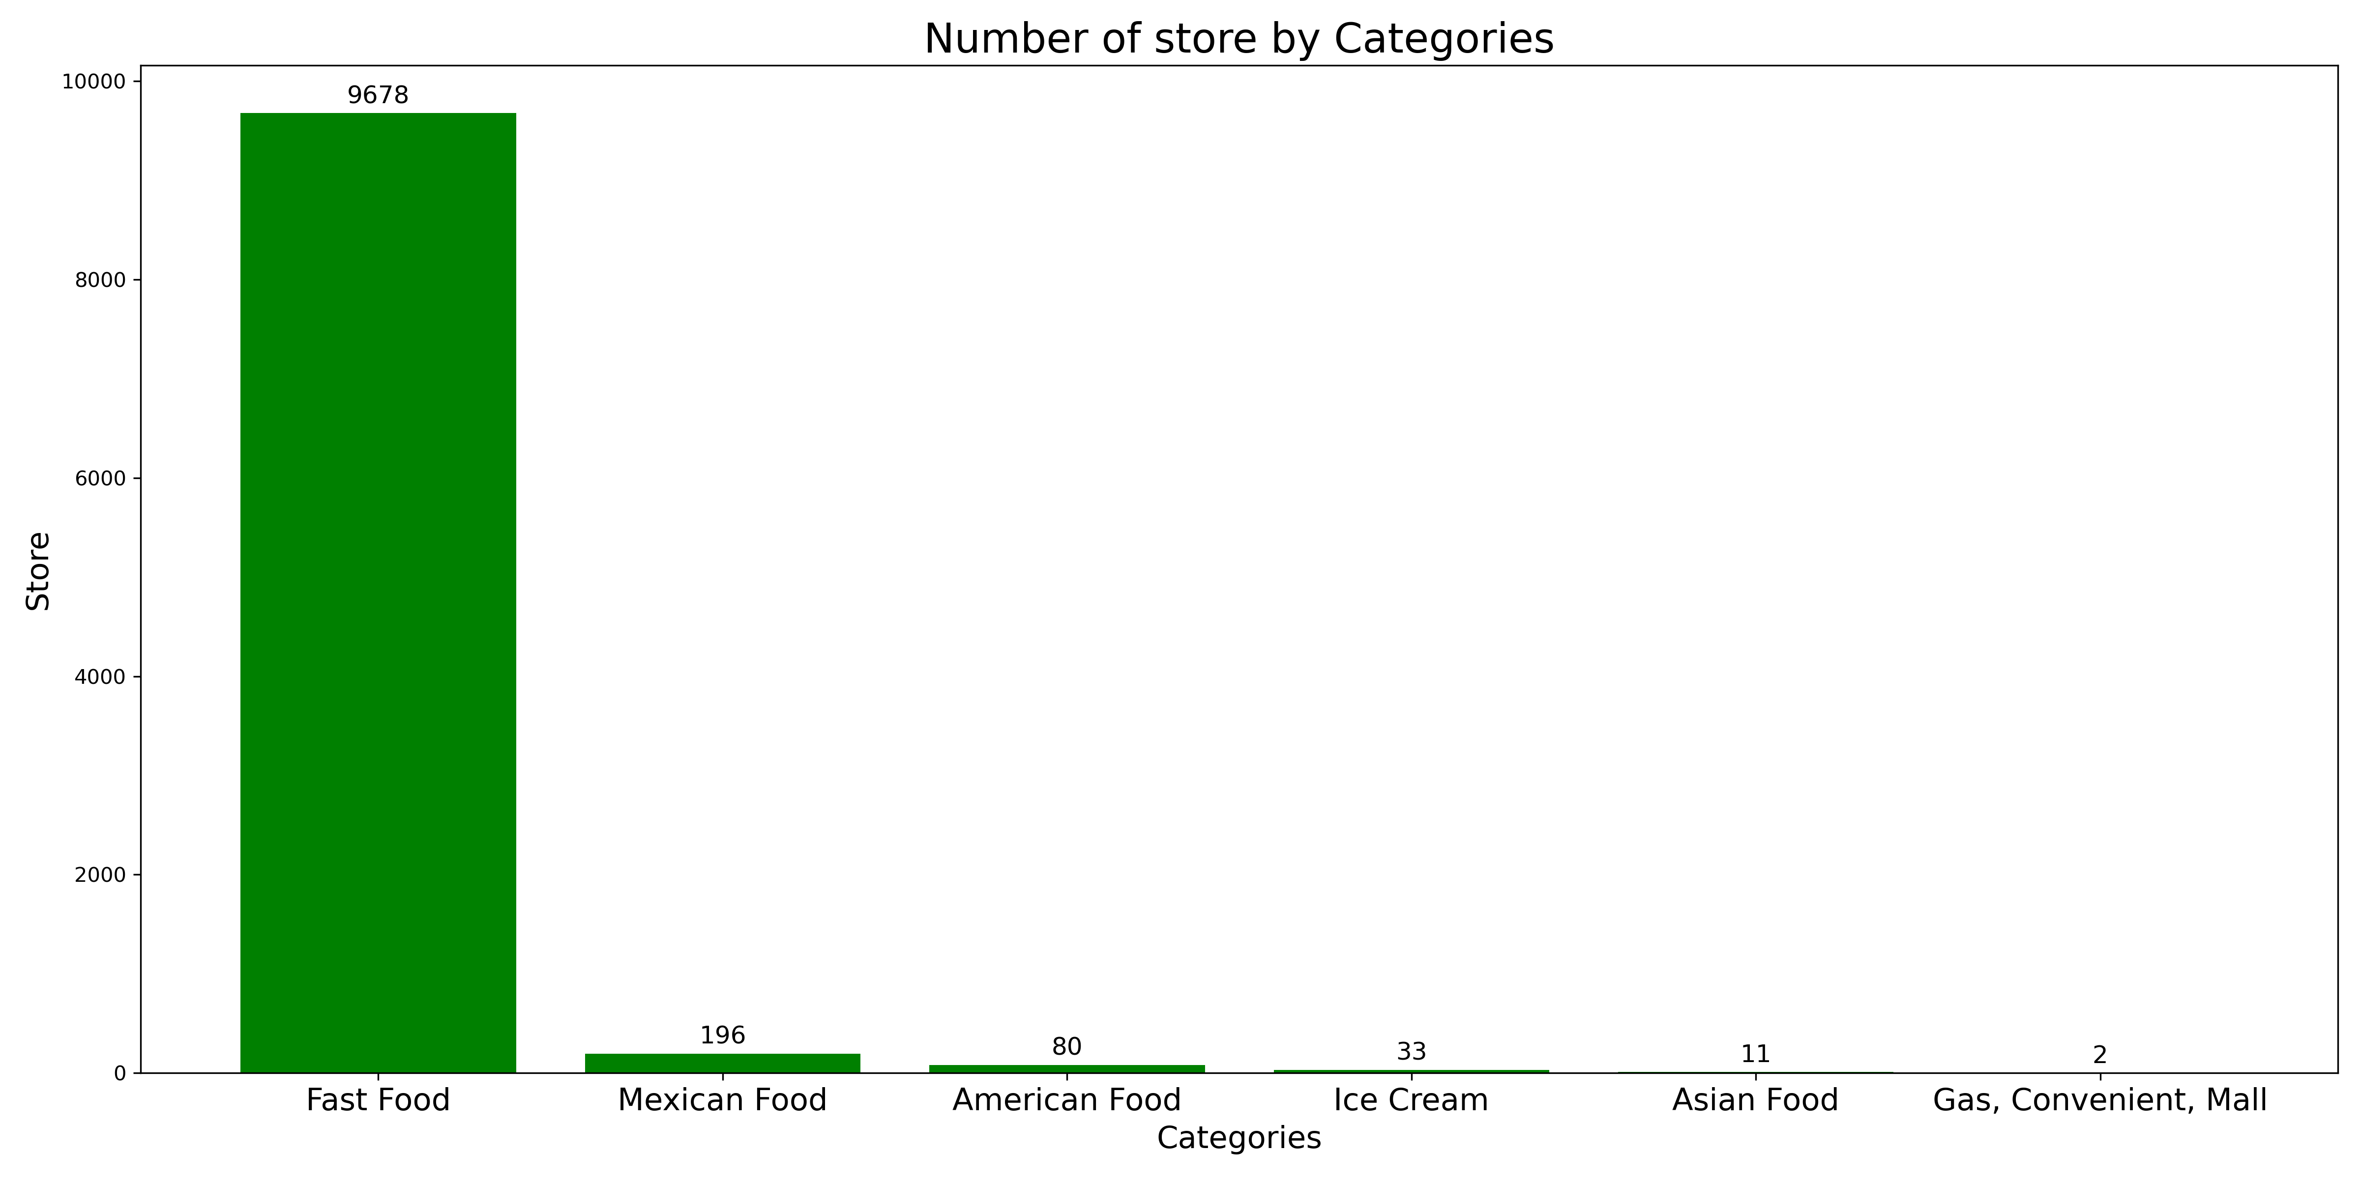
Fast-food is the most popular type of restaurant in the us
There are 9678 fast-food restaurant while only 196 Mexican food restaurants, 80 American Food restaurants, 33 Ice cream shops, 11 Asian Food, and only 2 Convenient/Gas/Mall.

Slide 8
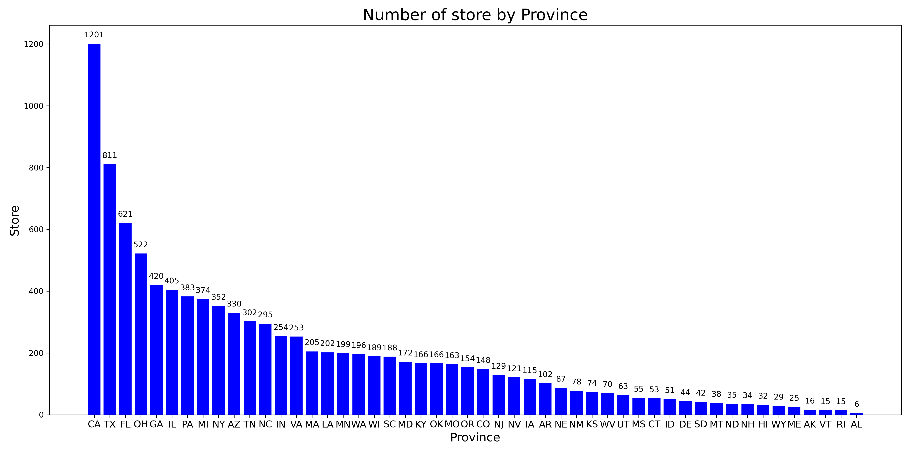
CA, TX, FL are the top 3 states having highest number of stores
California, Texas, Florida are known as the top active and crowded states, that’s why restaurants are mostly located here.
Notes:
Out of control consequence

Slide 9
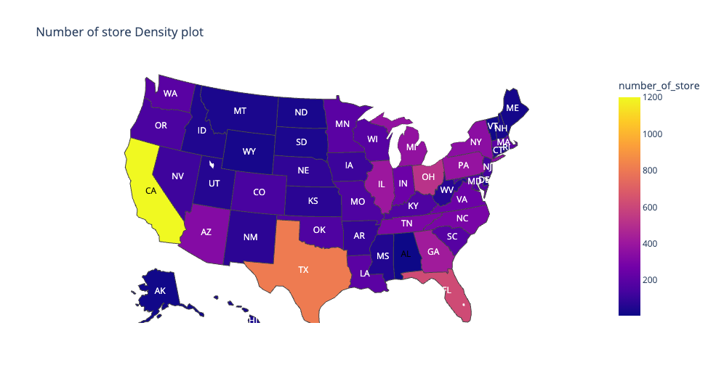
Restaurants mostly concentrate at crowded, warm and coastal states
Seeing the store distribution on the map, we can see that restaurants are more at crowded, warm and coastal states such as: CA, TX, FL, OH, AZ.
And cold, inland states have less restaurants

Slide 10
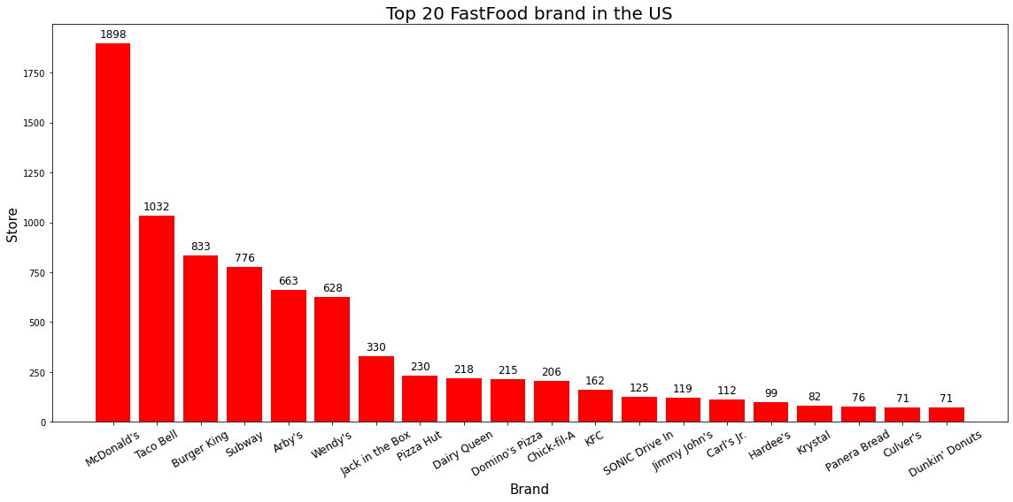
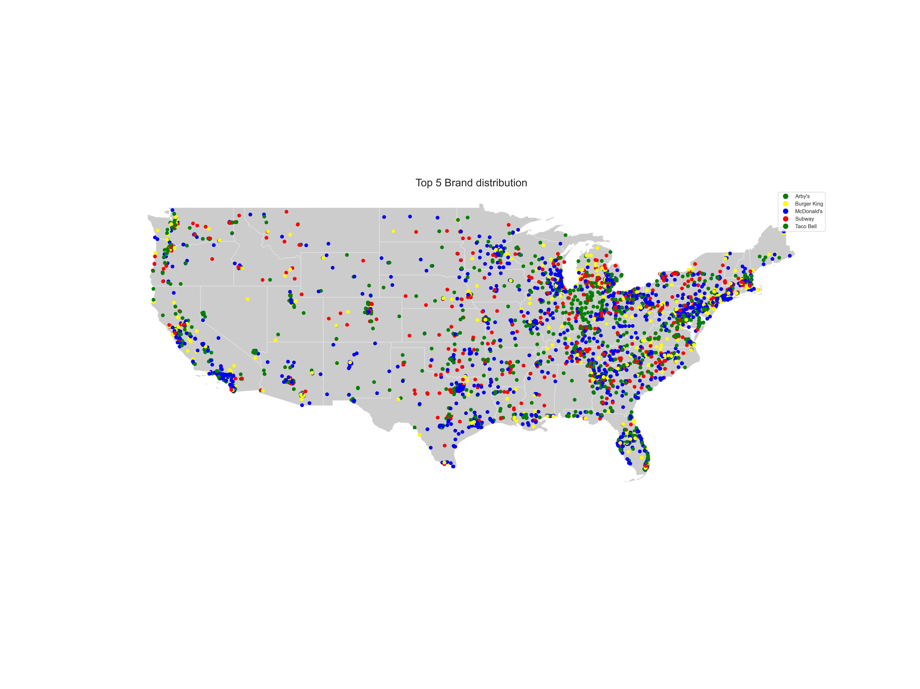
McDonald’s is the market leader in the us with widen distribution across the country.
With 1898 stores and mostly distributed in all the states of the US, McDonald’s is considered as the market leader in fast-food industry in the US.
Taco Bell and Burger King also have a strong store system but not dense as McDonald’s.

Slide 11
COnclusion
We can confirm that fast-food is the most popular type of restaurant in the US with 9678 stores across the country.
California, Texas, Florida are known as the top active and crowded states, that’s why restaurants are mostly located here. Restaurants are clustered in crowded, warm and coastal states such as: CA, TX, FL, OH, AZ
In this fast-food industry, McDonald’s is considered as the market leader with 1898 stores distributed at all the states in the US. Taco Bell and Burger King are also big players when having store systems but not dense as McDonald’s.

Slide 12
Thank you

